Slide 2
COMPANYHISTORY
Founded in 1990 in the United Kingdom.
Leaders in the field of cosmetic consumer research
Expanded to the United States in 2014
Global research capabilities

Slide 3
ADVANTAGES
Geographical Locations
Markets Served
Services Provided
Subject Database
Quality Assurance
Expertise In Testing
Internationally Sought After Malodor Mudges

Slide 4
COMPANYOVERVIEW
Industry experts in Consumer Product Testing
Key Staff Average > 20 Years Experience
Core Team Together > 15 Years
3 Research Sites
Perform Contract Testing Services
Industry Recognized Published Experts
35,000 Global Subject Database

Slide 5
QCREGULATIONS
ICH GCP
EMEA
FDA compliant
Monthly external QC audit
Internal QC:
Study documents
EC approval
Study active phase

Slide 6
SUBJECTDATABASE
Our locations, experience, and strategic partnerships ensure we will meet the enrollment benchmarks for your clinical study.
Global database of 35,000 panelists with full medical histories
Age range 0-70+
Special consumer profiles – Habits and Brand Loyalty

Slide 7
SUBJECTDATABASE
Recruiters have 20+ years of clinical trial expertise
Exclusive SEO for recruiting specific demographics
Physician partnerships for direct recruiting
Highly effective recruiting strategy
Community education, outreach, event sponsorships and PR
Digital media: social media, banners, email marketing
Word of mouth
98% subject retention rate

Slide 8
SUBJECTDATABASE
Ethnic Panels
Indian
Asian
African
Hispanic

Slide 9
NJFACILITY
8,000 sq. ft. research facility
Climatically controlled hot room accommodates - 50 panellists
Full service wash/changing facilities
SPF suite & Spa
Wash/locker room and changing area
Spray room with extraction system
Numerous treatment rooms
Full service hair salon
Imaging suite (Visia CR)

Slide 10
FLORIDAFACILITY
11,000 sq. ft. research facility
2 Climatically controlled hot room accommodates - 50 panellists
Full service wash/changing facilities
SPF suite & Spa
Wash/locker room and changing area
Spray room with extraction system
Numerous treatment rooms
Full service hair salon
Imaging suite (Visia CR)

Slide 11
HOTROOM 50 SEAT CAPACITY

Slide 12
MARKETSSERVED
Personal Care
Toiletries
OTC
Skin Care
Eye Care
Hair Care
Oral Care

Slide 13
SERVICESPROVIDED
SAFETY
EFFICACY
ACCEPTABILITY

Slide 14
SAFETY
SERVICESPROVIDED
PRIMARY IRRITATION PATCH TESTING
Standard 1, 2 & 3 application patch tests
96-Hour Patch Test
Frosch & Kligman Soap Chamber Test
SECONDARY IRRITATION PATCH TESTING
HRIPTs
Jordan & King
Kligman
Shelanski

Slide 15
SAFETY
SERVICESPROVIDED
Open Application
Human Eye Direct and Non-Instillation
Comedogenicity
Phototoxicity
Photosensitization
Home-Use

Slide 16
SPF
SERVICESPROVIDED
SPF – Global Regulations
ISO 24444
Europe
Australia/NZ
Japan and Pacific Rim
South Africa
FDA
USA & Canada
SPF – Types of Study
Water-resistant
Very Water-Resistant
Sweat-resistant

Slide 17
APD
SERVICESPROVIDED
ANTI-PERSPIRANT STUDIES
Gravimetric method
“Hot room”
DEODORANT STUDIES
Hedonic & Intensity
Axillae
Feet
Vests, Shirts, Socks

Slide 18
ANTIAGING
SERVICESPROVIDED
TEST
Anti-Wrinkle (Profilometry)
Hyperpigmentation (Chromameter)
Skin Elasticity (Cutometer)
Moisturisation Test (Corneometer)
Compare Skins at Specific Ages
CLAIM
“Anti-Aging”
“Makes my Skin Look 10 Years Younger”

Slide 19
ANTIWRINKLE
SERVICESPROVIDED
PROFILOMETRY TEST
Visual and Instrumental Assessment
Generate skin replicas using Silflo
Perform LASER profiling
CLAIM
“Anti-Wrinkle”
“Wrinkle-Defense”
“Reduces the appearance of wrinkles by x% in x weeks”

Slide 20
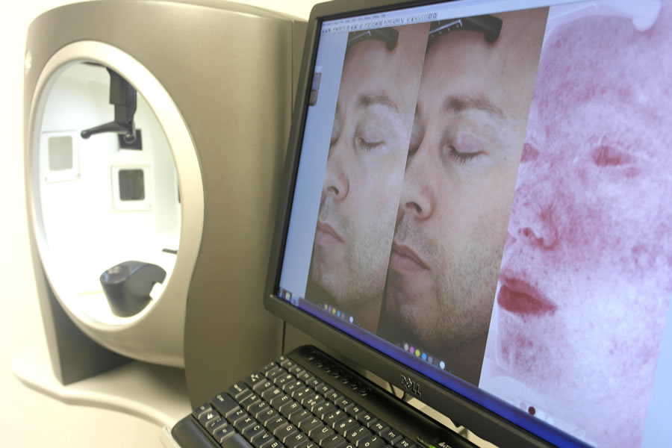
FACIALIMAGING
SERVICESPROVIDED
CANFIELD VISIA CR
Image capture for wrinkles and fine lines, skin texture, coloration/evenness, photodamage, vascular features and porphyrins (P. acnes)
High Resolution
Rapid Capture Time
PreSet Lighting Modes
Minimises Technician Error
Produces great B/A images

Slide 21
SKINLIGHTENING
SERVICESPROVIDED
SKIN LIGHTENING
Visual and Instrumental Assessment
Chromameter, Mexamater
CLAIM
“Improves skin tone”
“Improves skin luminosity”
“Helps reduce the appearance of hyper pigmented age spots”
“Brightens skin”

Slide 22
SKINFIRMNESS
SERVICESPROVIDED
ELASTICITY / FIRMNESS
Visual and/or Instrumental
DTM, Cutometer
CLAIM
“Firming”
“Improves the elasticity of your skin”

Slide 23
MOISTURIZATION
SERVICESPROVIDED
MOISTURIZATION (Emollient)
In-Use or Controlled Application
Visual and/or Instrumental Assessment
TEWL
Evaporimeter, Tewameter
CLAIM
“Improves the skin’s natural barrier”
“Emollient”
“Kind to skin”

Slide 24
MOISTURIZATION
SERVICESPROVIDED
MOISTURIZATION (Humectant)
In-Use or Controlled Application
Visual and/or Instrumental Assessment
Corneometer, Dermal Phase Meter (NOVA)
CLAIM
“Provides moisture-boosting hydration”
“Revitalizing Moisturizer”
“Moisturizes for up to x hours”

Slide 25
ANTIINFLAMMATORY
SERVICESPROVIDED
ANTI-INFLAMMATORY TEST
Compromise skin with
SLS (typically 0.75%)
UV (typically 4x MED)
Follow treated & untreated sites to resolution (visual or blistering)
CLAIM
“Anti-Inflammatory”
“Restorative”
“Skin soothing” (after sun)

Slide 26
OXIDATION
SERVICESPROVIDED
TISSUE OXYYGENATION STUDY
Transcutometer monitor (TCM4)
Partial oxygen (pO₂) values
8.5kPa (pre) to 10.5kPa (post)
CLAIM
“Clinically proven to help increase oxygen levels in the skin ”

Slide 27
LESION
SERVICESPROVIDED
LESION COUNT STUDIES
Non-Inflamed:
Microcysts
Blackheads (open comedones)
Whiteheads (closed comedones)
Inflamed:
Pustules
Papules

Slide 28
SLIMMING
SERVICESPROVIDED
SLIMMING STUDIES
Lipid reduction
Ultra-sound
Circumference reduction
Arms
Thighs
Tummy
Weight reduction
BMI

Slide 29
HAIRCARE
SERVICESPROVIDED
HAIR CARE SUDIES
Anti-Dandruff
Expert Graders
Strengthening
MTT (Mini Tensile Tester)
Hair Brush Friction Method
Colour Retention
Chromameter

Slide 30
HAIRCARE
SERVICESPROVIDED
HAIR CARE SUDIES (Stylist / Panelist Assesments)
Oiliness
Anti-Frizz
Colour Retention
Shine
Frizziness
Bounce
Volumising
Refreshing properties
Smell
Feel
Access to custom designed instrumentation

Slide 31
OTHERSTUDIES
SERVICESPROVIDED
Diaper Studies
Baby Wipes
Depilatory
Feminine Hygiene
Wear Tests
Foundations, Mascaras, Lipsticks
Nail Strength

Slide 32
ACCEPTABILITY
SERVICESPROVIDED
Taste Tests
Healthy or Taste-Compromised Panels
Wear Tests
Contact Lens, Dentures Lipsticks, Mascaras
Preference Tests
Fragrances, Packaging

Slide 33
INVESTIGATOREXPERTISE
Novel Protocol Design
Skin Graders
Odor Assessors
Hair/Scalp Assessors
Bioinstrumentation
Recruitment
CRF/eCRF Development and Completion

Slide 34
CONSULTANTPHYSICIANS UNITED KINGDOM
Dr Anthony Ormerod, MB BS MRCP FRCP Medical Director; Consultant Dermatologist / Surgeon | Dr Geetha Kugan, MRCP DCH FROPCH Consultant Paediatrician
Dr M Idrees, BSc MBBS DO MRCOphth Practising Consultant Ophthalmologist | Dr John Simmons, MB BS FRCP Practicing Consultant Pharmacokineticist
Rachel Holley Practicing Midwife | Dr Mary Summerville, MB BS Practicing Consultant Gynecologist

Slide 35
CONSULTANTPHYSICIANS UNITED STATES
Jerry Bagel, M.D. Dermatologist | John Edward Vine, M.D. Dermatologist
Daniel N. Sauder, MD Dermatologist | Arthur W. Perry. MD, FACS Plastic Surgeon
Stephen Hudis, DDS, FACP Dentist | Suzanne K. Jadico, MD Ophthalmologist
Anita Saha, M.D. FACOG Obstetrics and Gynecology | Joyce Baker, MD Dermatologist
David A. Wrone, MD, FAAD Dermatologist | Scott E. Eder, MD, MACOG, FACS Gynecologist
Manishi Mukherjee, MD Obstetrics and Gynecology | Daniel Hogan, MD Dermatologist
Lynne Ellis, MD Pediatrician

Slide 36
QUALITYASSURANCE
Experienced Quality Assurance Manager with 27 years of experience
In-house developed SOPs
ICH GCP, EMEA, FDA compliant
QUALITY CONTOL
EXTERNAL QC:
Sponsor audits -at least once a month
INTERNAL QC of:
Study documents
EC approval
Study active phase

Slide 37
QUALITYASSURANCE
PROCEDURES
TRAINING
Compliant with:
ICH GCP, EMEA and FDA regulations
Bi-Monthly internal staff training
Frequent “on the job” training
Periodic external training

Slide 38
WHYPCRCORP NO COMPROMISE ON QUALITY, RAPID RECRUITMENT
QUALITY
PERSONEL
RAPID
RECRUITMENT
COST
Experienced Quality Assurance Manager with 27 years experience
In-house developed SOPs
ICH GCP, EMEA, FDA compliant
Majority of staff average > 15 years experience in clinical trials
Core team together > 10 years
Focused, knowledgeable team, very adaptable, user friendly and dedicated to serving customers
Good patient population on PCR database (ACTMS)
Efficient propriety database system
Access to UK & CEE subject/patient population
Access to experienced sites
Good investigator network
Focused, efficient operation

Slide 39
GLOBALRESEARCH

